Slide 1

Team name : BISQUAD
Team Captain Name : Suryadevara Sanjana
Team Captain Email : sanjanasuryadevara2004@gmail.com
No. of Team Numbers : 2
Team Details : Suryadevara Sanjana
Kollu Bargavi

Slide 2
DOMAIN AND PROBLEM STATEMENT
Domain : Smart Education
Problem Statement : Gamified Learning

Slide 3

Gamified Learning
The Gamification of Learning is an educational approach that seeks to motivate students by using video game design and game elements in learning environments.
The Goal is to maximize enjoyment and engagement by capturing the interest of learners and inspiring them to continue learning.
Gamification is the introduction of game elements into a traditionally non-game situation .

Slide 4
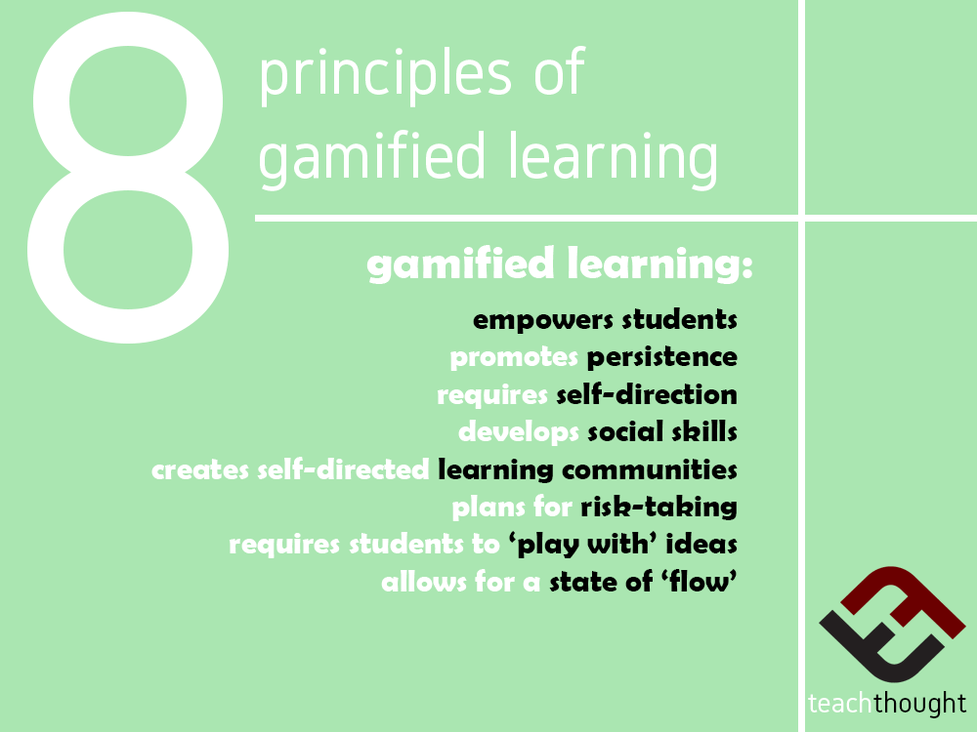

Slide 5
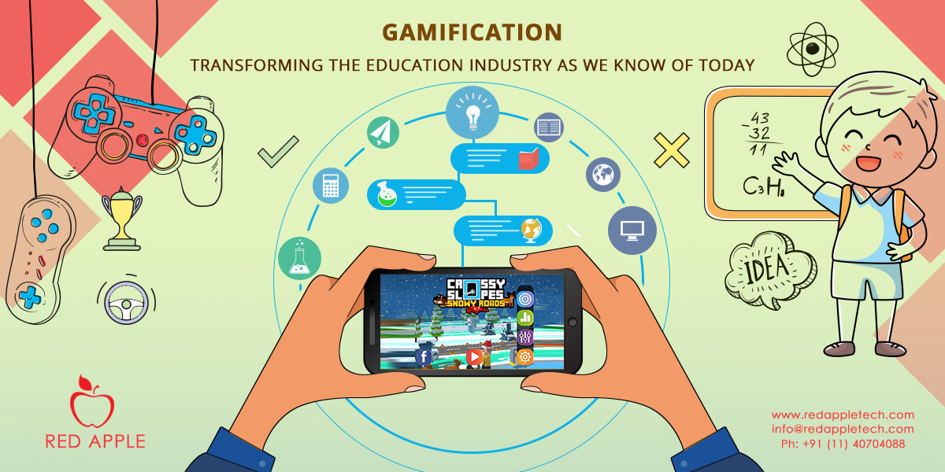
PROBLEM
Nowadays, Children hate the learning process because they have to repeatedly learn the same thing for a long time. Making learning an interesting activity can be of great help . So why don’t we gamify the learning so children could have fun while learning .

Slide 6
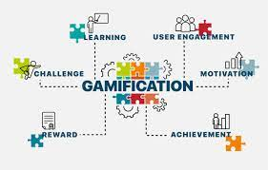
SOLUTION

Slide 7
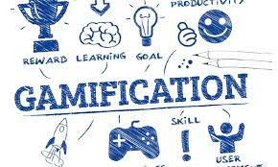

Slide 8
Games Format
All the games will based on content a toddler or a pre-teen has to learn at their particular age .
For a toddler , it maybe hearing rhymes , identifying things or objects , learning numbers , picture matching .
For a pre-teen , it will be based middle school curriculum that is based on the subjects the curriculum includes .
The game format will be changed based on the age of the individual.

Slide 9



FOR A TODDLER – GAME

Slide 10
Game Rules
The Game Begins , different categories will appear for choosing for example fruits , vegetables , animals .
On choosing the category , the toddler has to identify the thing or object displayed on the screen .
After choosing the right answer the toddler gets coins and if the answer goes wrong there will be 2 more chances to answer the question given .
If the all answers are wrong , no coins are rewarded .

Slide 11
For a pre-teen – Game
Based on the subject in the curriculum ,
For example , Math which include addition , subtraction, multiplication and division at the pre-teen age .
Using different objects while teaching rather than using the same old numbers .
This enhances interest while learning and leads to a feeling wanting to learn more .
Other subjects like be Science can taught using visuals rather than teaching verbally .

Slide 12
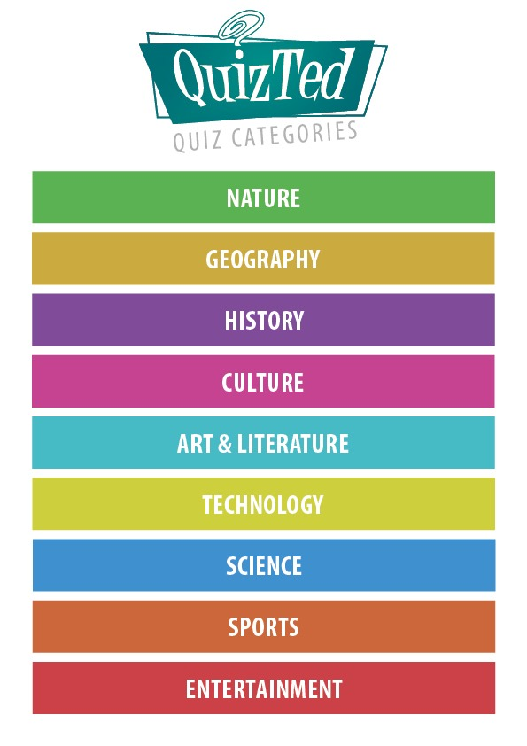
Choose a subject

Slide 13
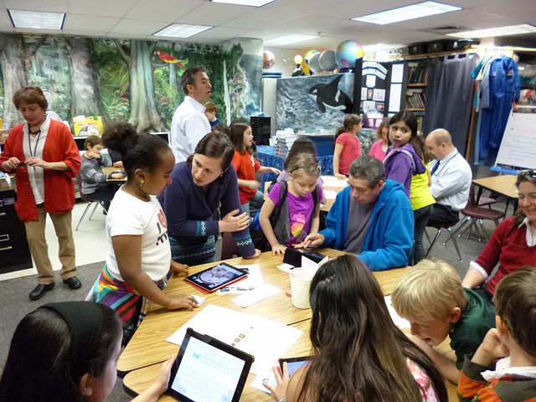

Slide 14
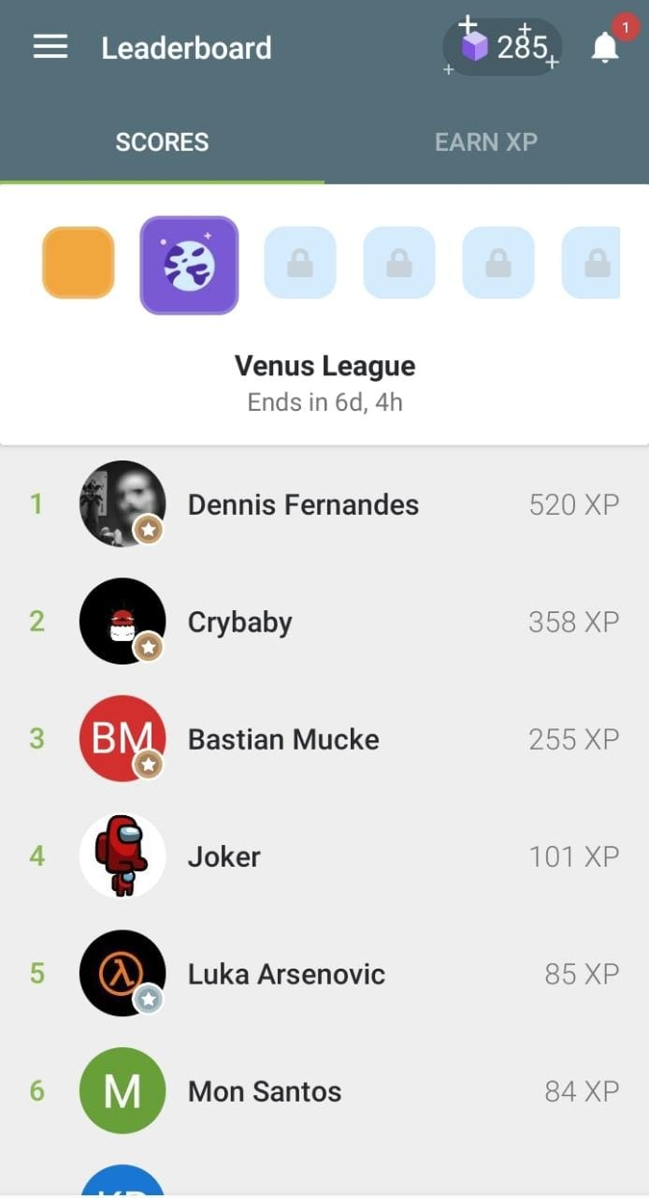
SCORE BOARD
Based on their level that is the score of the players , they will be segregated .
Then they can move on to next level by increasing their score .

Slide 15
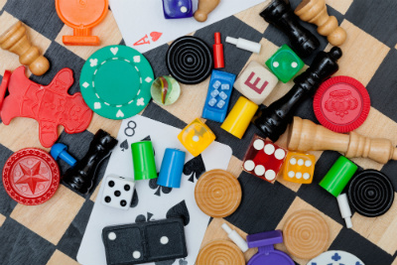

REWARD TIME
Depending on the scores of individuals that is they collect coins using the coins the players can buy goodies like stationary , toys , candies , board games .

Slide 16
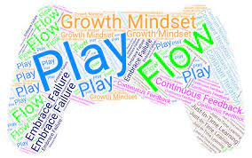
Gaming Mindset
Play – Games = Goals + rules +
play
Growth mindset
Learn from Failure
Flow

Slide 17
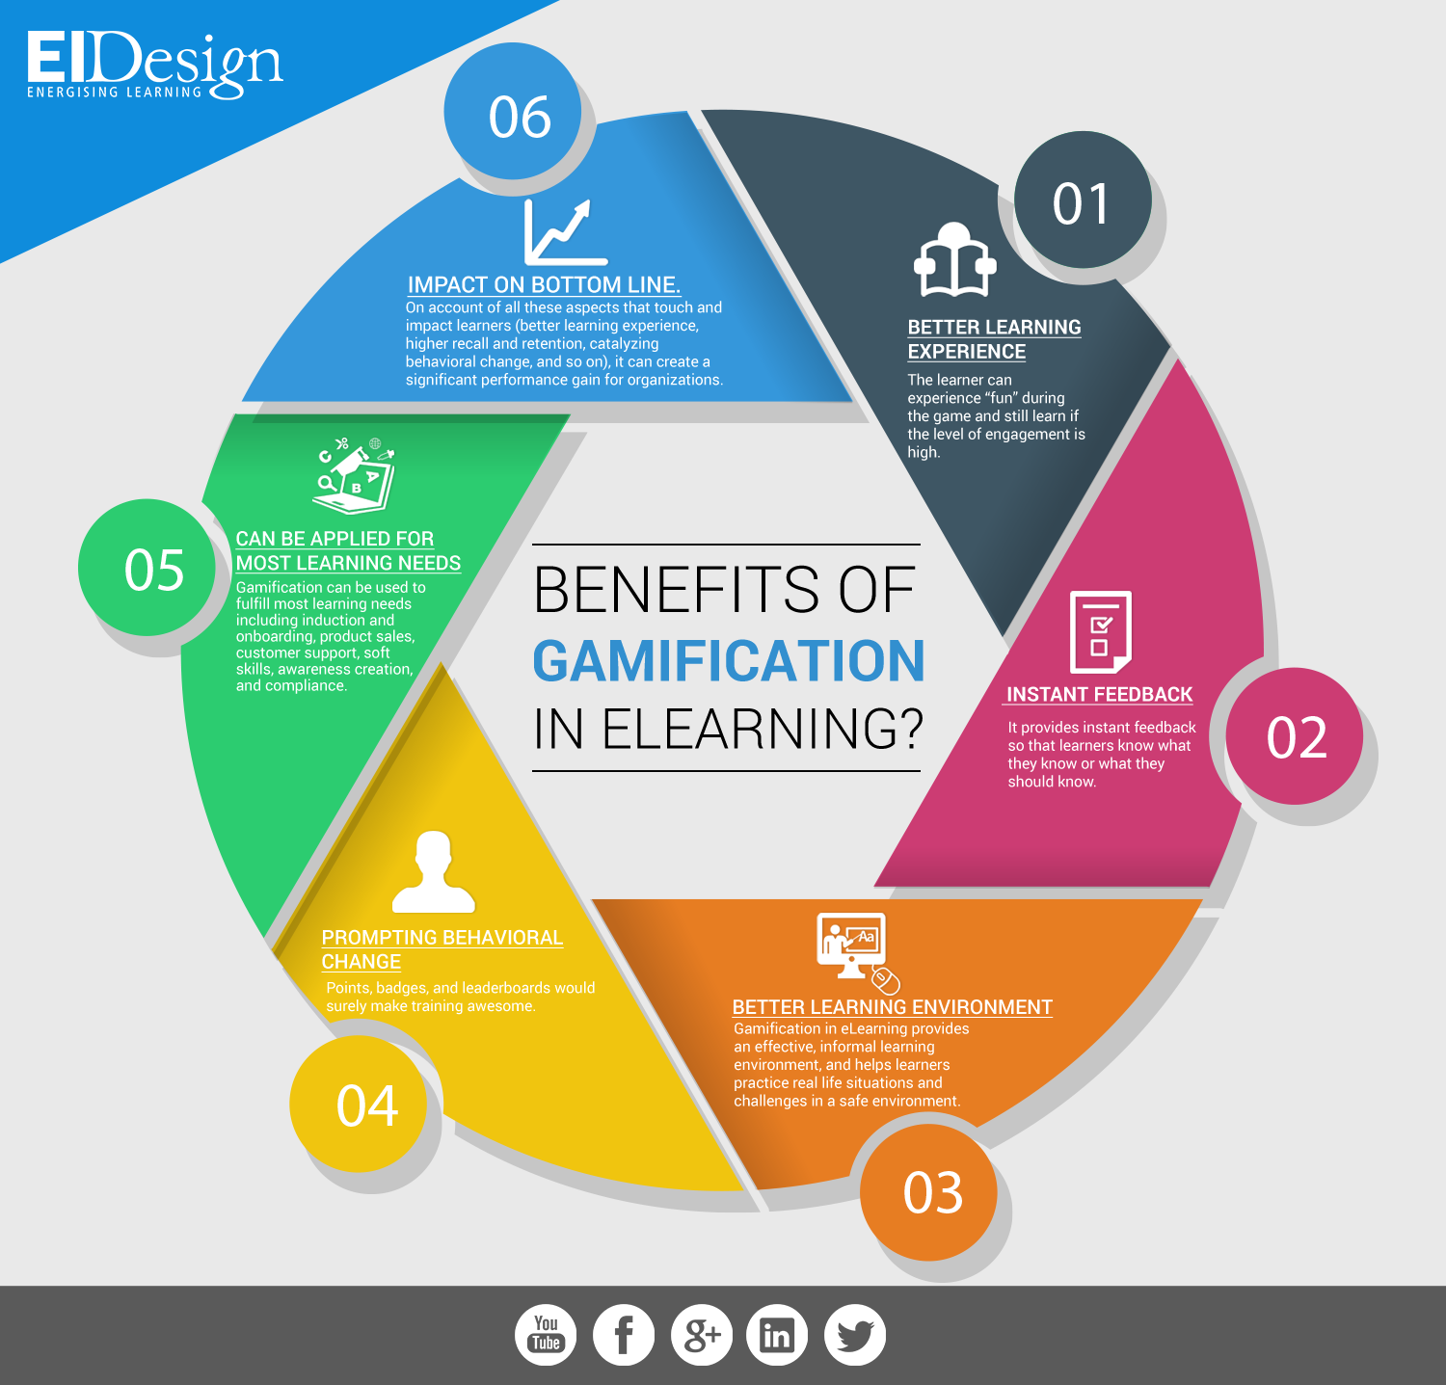
Benefits of Gamified Learning

Slide 18
MOTIVATION FOR THE IDEA
Nowadays , students from all the age group lose their interest during classes and their mind wonders all around this leads to loss in their learning so why not gamify the learning process so that it actually catches children's attention and they could learn with interest and it would also be a more practical way of learning which can be understood more efficiently rather than verbal lectures .
Action - Destruction, Excitement
Social - Competition, Community
Mastery - Challenge, Strategy
Achievement - Completion, Power
Immersion - Fantasy, Story
Creativity - Design, Discovery

Slide 19
THANK YOU !

